Slide 1

Drone based Remote Sensing
Team Members:
Pranav
Gaurav
Nikhilesh

Slide 2
Abstract
Drone-based remote sensing technology has revolutionized data collection in various fields, offering unparalleled access to hard-to-reach areas and enabling high-resolution data acquisition. In this report, we explore the integration of humidity, temperature, and gas sensors onto drones for remote environmental monitoring applications. We discuss the importance of these sensors, their deployment on drone platforms, data collection strategies, data processing techniques, and potential applications. Additionally, we highlight the advantages and challenges associated with drone-based remote sensing using these sensors and provide insights into future research directions.

Slide 3
Introduction
Drone technology has transformed the field of remote sensing by offering a cost-effective and efficient means of data collection. Traditional methods of environmental monitoring often face challenges in accessing remote or hazardous areas. However, drones equipped with various sensors provide a solution to these challenges by enabling real-time data acquisition. In this report, we focus on the integration of humidity, temperature, and gas sensors onto drone platforms for environmental monitoring applications.

Slide 4
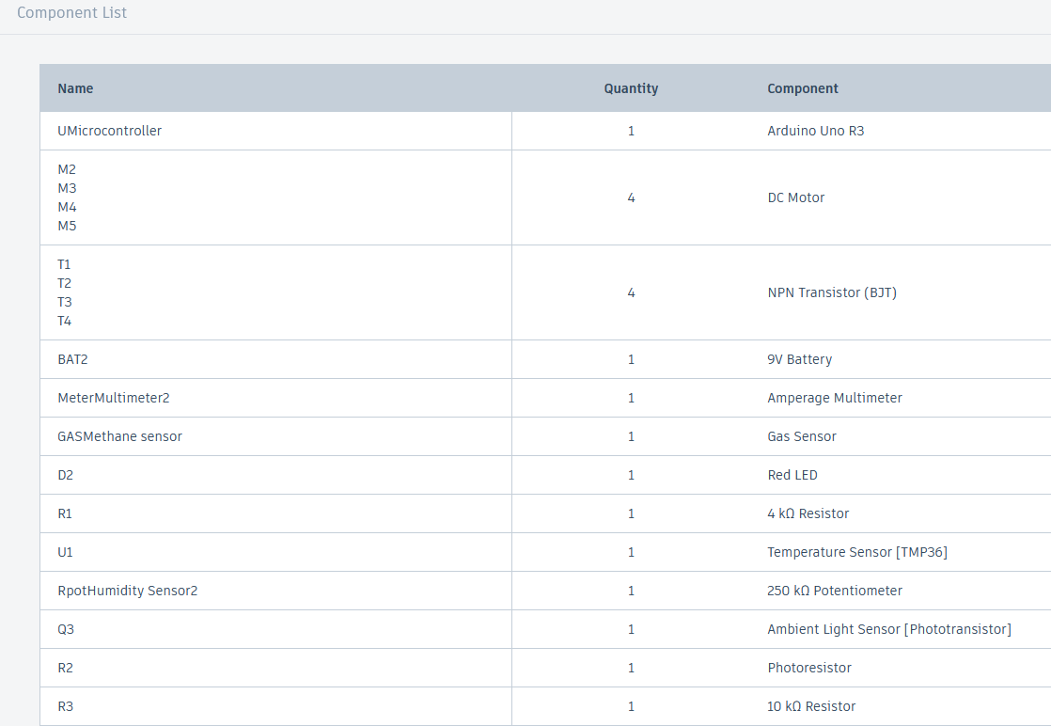
Components Required

Slide 5
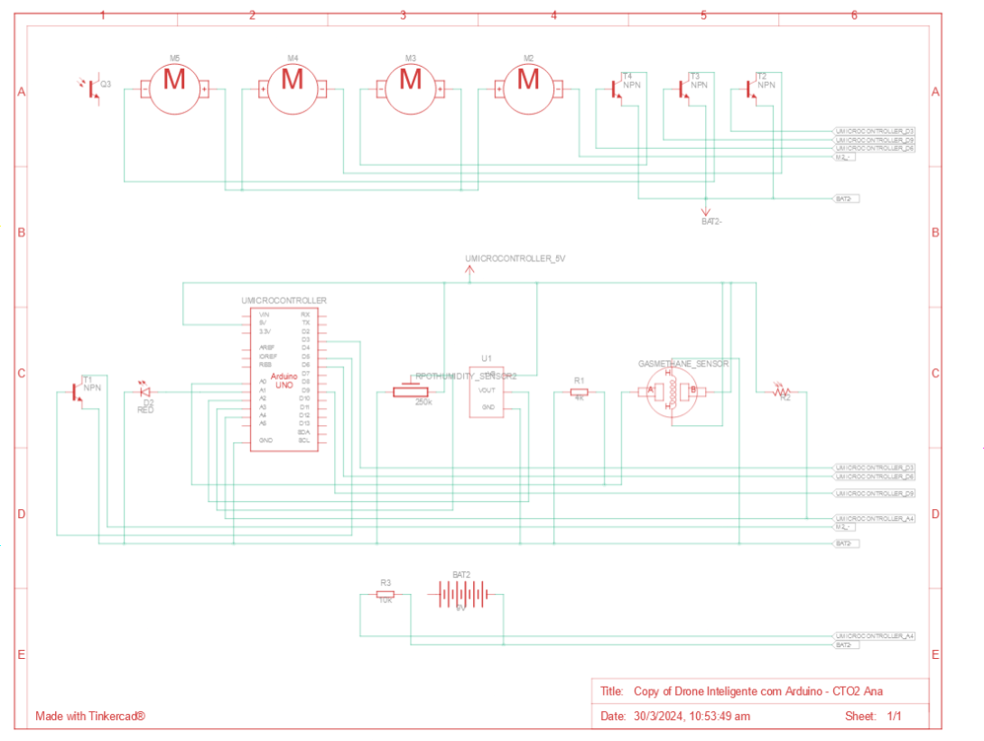
Schematic Diagram

Slide 6
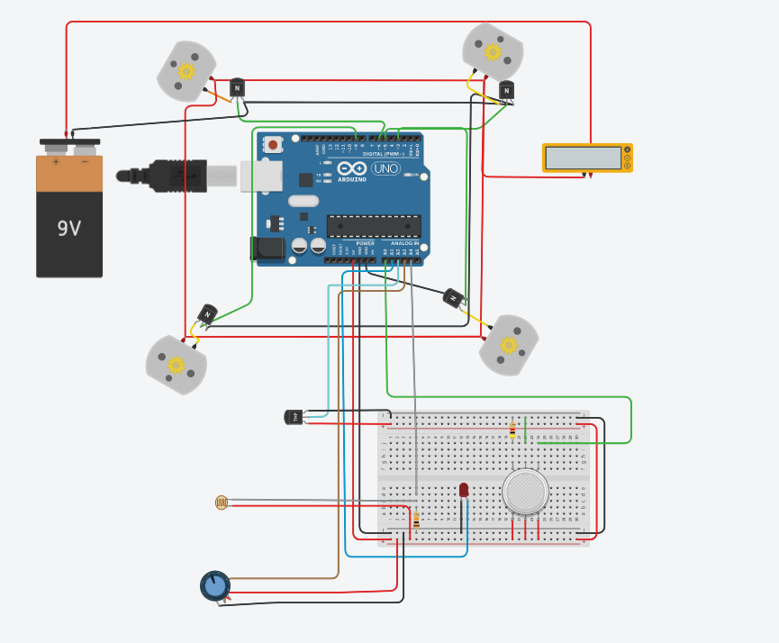
Tinker Cad

